Slide 1
Relative Age
Principle of Superposition

Slide 2
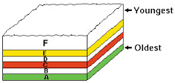
Principle of Superposition
Also known as Relative age
Age of fossils and rock can be dated in relative to each other.
Not an exact quantitative age

Slide 3
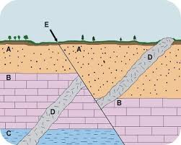
Undisturbed vs folded layers
Undisturbed layers: can be dated easily. The youngest is always on top of the oldest layers.
Folded/Disturbed layers: you need to take into account faults, igneous rock, and metamorphic rock.

Slide 4
Unconformities
Erosion away of whole or partial layers of rock.

Slide 5
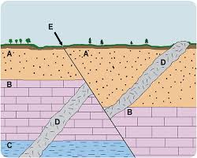
Igneous and fault lines
Igneous and fault lines cut through layers and are ALWAYS younger than the rocks they cut through.
Ex: E and D are younger than all layers of rock. However, E is the youngest because it cuts through D

Slide 6
Metamorphic rock
Metamorphic rock is always older than rock around it.

Slide 7
https://youtu.be/EadTLGMu3LI

